Slide 1
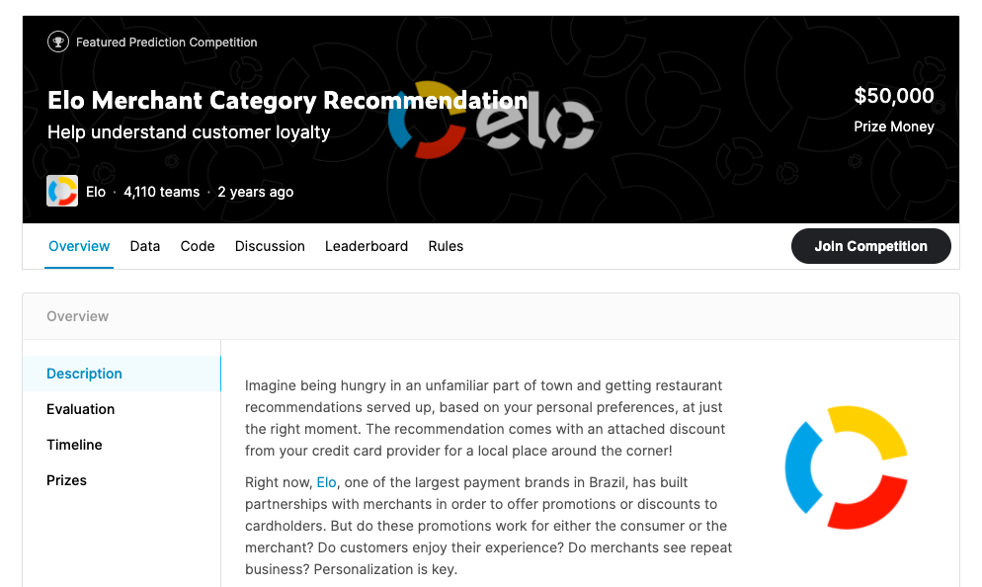
Team Project 2
Team 11:
Yuri takanabe
Nic Yabar
Olena Shumeiko
Taylor Ann Applewhite

Slide 2
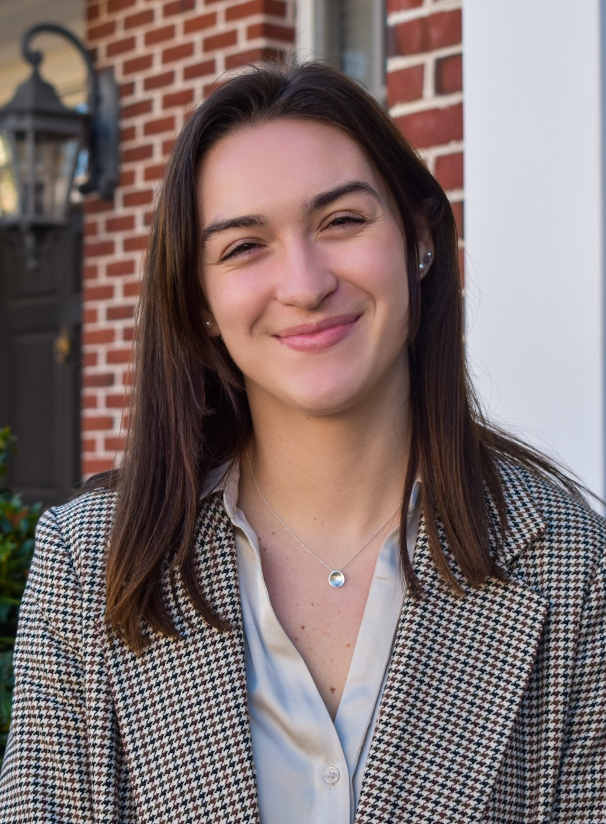
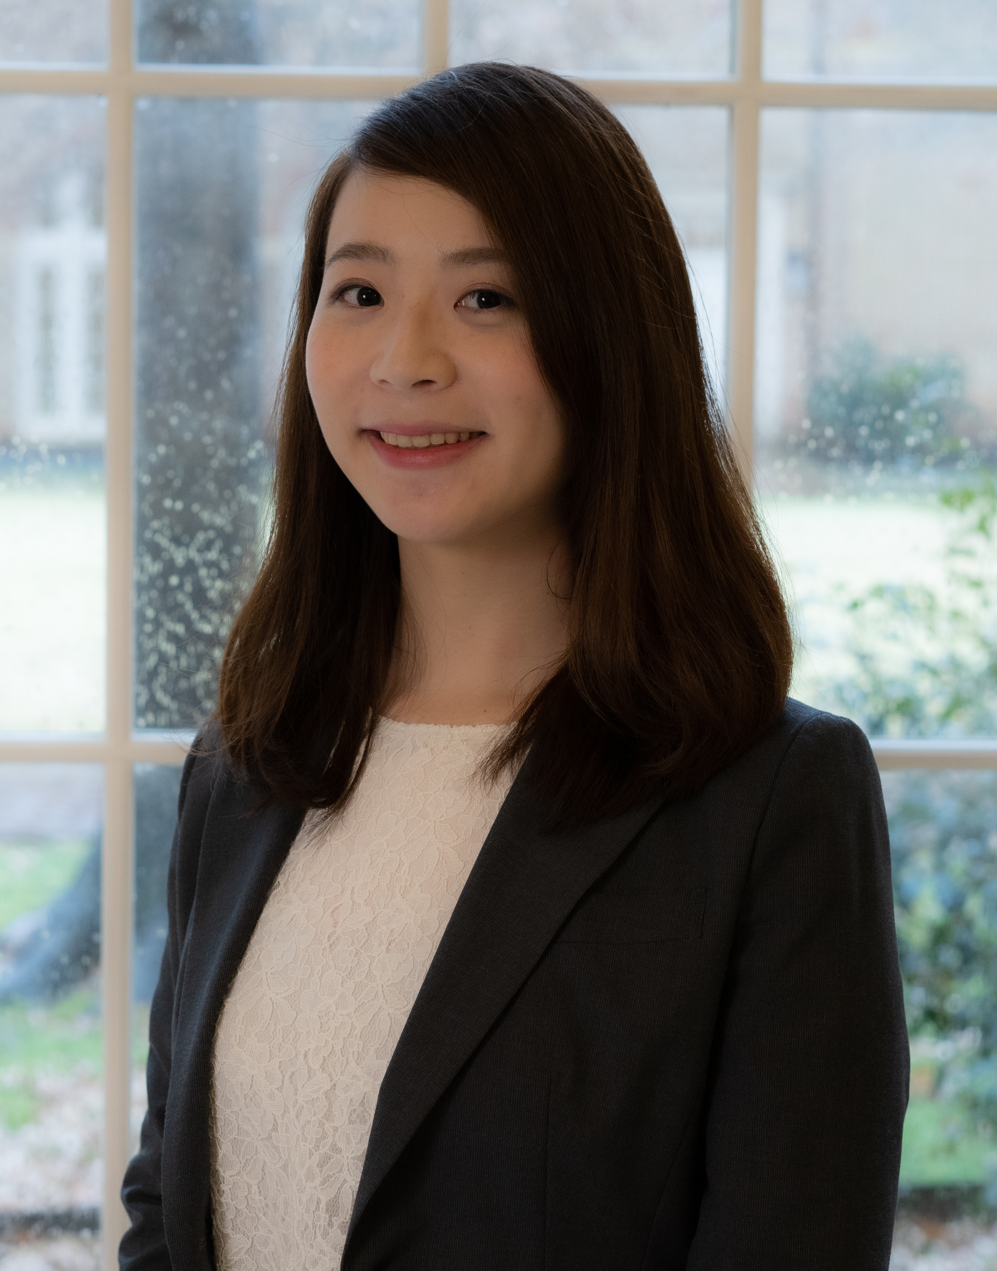


Our Team
Taylor Ann Applewhite
Yuri Takanabe
Olena Shumeiko
Nic Yabar

Slide 3

Data Overview
What’s the objective?
To help both customers and merchants by predicting customer loyalty scores
Where does the dataset come from?
Created by Elo (one of the largest payment brands in Brazil)
Simulated data not based off real customers
What are the key features?
Predicted variable : customer loyalty score
Features: information about cards, transactions, and merchants
Used selected Kaggle submission's important features code to determine top 20
Notes:
An overview of the Kaggle competition - what's the objective? where does the dataset come from? what are the key features?

Slide 4
Data Overview (conc.)
File descriptions
train.csv : the training set
test.csv : the test set
historical_transactions.csv : up to 3 months' worth of historical transactions for each card_id
new_merchant_transactions.csv : two months' worth of data for each card_id containing ALL purchases that card_id made at merchant_ids that were not visited in the historical data
merchants.csv : additional information about all merchants / merchant_ids in the dataset.
Notes:
An overview of the Kaggle competition - what's the objective? where does the dataset come from? what are the key features?

Slide 5
Selected Kaggle Submission
Submission by Julia Lee
https://www.kaggle.com/juliaflower/feature-engineering-xgboost-lgbm-with-r
Silver award on the Leaderboard
Private Score 3.70065
Public Score 3.79125
Feature engineering:
Created 113 features for training
Models used:
XGBoost
LightGBM
Average of XGBoost and LightGBM predictions
Critique points:
Extreme outliers
Date variables are used as numeric
Created features include infinite numbers
Notes:
A brief critique of select Notebooks on this competition available in the public domain - The team should critically evaluate other people's published work using concepts learned from the Machine Learning 1 and Machine Learning 2 coursework.

Slide 6
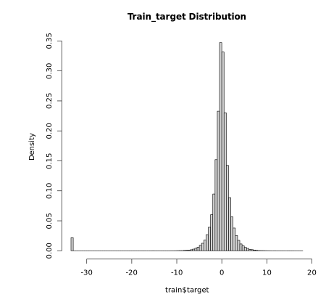
Our Solution
Overview
Load files
Sample down randomly (to 10%)
Remove outliers (filter(train, target > (-30)))
Feature engineering
Transaction data (historical / new)
Merchants data
Training data
Split data into training / test subsets
Training models
XGBoost with all 111 features
XGBoost with selected 20 features
Lasso with 111 features
Notes:
The first step that our team took was to randomly sample the data down to 10% for simplicity reasons and to avoid a long processing time for the data. Our results with the smaller dataset followed that of the larger data set so we were not concerned with the difference.
Our second step that we took was to observe for any outliers in the data set. We used the histogram in order to identify what outliers there may be and we did observe one at –30. Our group elected to remove this data point as it is insignificant to our analysis and may skew our results.
We decided to use Ms.Lee's feature engineering for creating new variables based on the historical, new, merchant, and training transaction data in order to gain more insight into customer purchase behavior that can help us determine their loyalty scores. Some of the key engineering that we did was manipulating the Transaction data.
Number of merchants for each card_ID and merchant category
Number of unique merchants for each card_id
Number of unique merchant categories for each card_id
Amount of customer purchase
Recency of a customer purchase
Number of purchase installments
Frequency of customer purchases
Merchants data: how many transactions occurred at each merchants
Training data : term between month of first purchase and data collected month (2018-2)
For our teams solution we chose to convert more variables to factors as it was the more appropriate choice with regards to the data. For example we found that the variables "month" and "year" were left as numbers instead of factors. This affects the result slightly as the categorical variables cannot influence the results to the desired level.
When we observed the importance of the variables in the kaggle solution we decided to target the 20 most important variables because we wanted to reduce the complexity of the model and avoid possible overfitting of the model. That is a real concern when dealing with the 116 variables that Ms. Lee chose to incorporate.
We found that the solution used by MS. Lee to be very confusing at some points and generally over complicated. The replicability of the code was difficult as there is a lot of specific steps that are taken that cannot be translated to other possible models.
We decided that it would be a better solution if we simplified the model and the approach. As we have learned from our courses this year, complexity is not always rewarded with efficiency or performance.
Our team decided to explore other models in order to see if they would perform better. The models we chose to investigate in addition to the ones previously mentioned were a simpler XGBoost model and a lasso model.
We simplified the model by choosing the top 20 most important features that we found after using the initial XGBoost model.

Slide 7
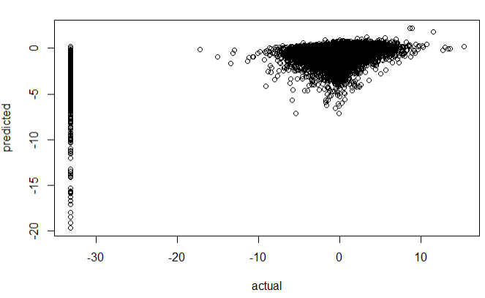
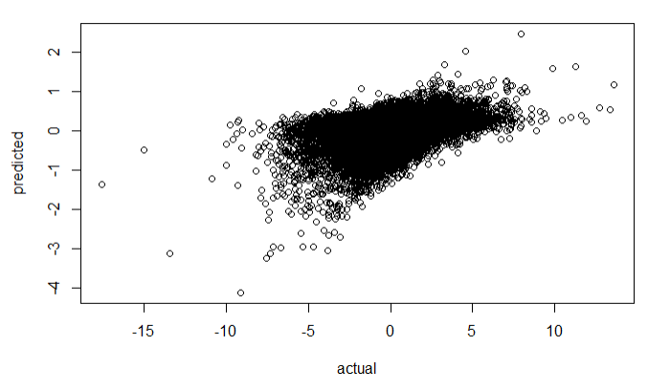
Results
 | Original Submission | Team 11
 | XGBoost | XGBoost | XGBoost with selected 20 features | Lasso
Train RMSE | 3.527710 | 1.610478 | 1.630570 | 1.693817
Test RMSE | 3.52801 | 1.620377 | 1.639819 | 1.697944
Actual loyalty score vs predicted loyalty score
Original Submission [XGBoost]
Team 11 [XGBoost]
Notes:
As we can see from the table on the slide, our models scores performed better than the Kaggle submission, so we can say that our decisions were effective and reasonable.
We can see that the XGBoost model when removing outliers improved our score the most, followed by the other models that we chose to make.
It is possible that the reason why Ms. Lee's submission score was so much higher than ours was that the outliers at the –30 range caused the RMSE score to go up a lot

Slide 8
Conclusion
Accuracy scores
Model Superiority
Diverse Applications
Data exploration and future use
Notes:
In conclusion our model returned to us a better RMSE score than the model that we critiqued so we were pleased to see that our decisions led to a better score.
We believe our model to be better than the one by Ms. Lee as it uses cleaner data that is structured more appropriately for the business problem we were attempting to solve. Additionally in the initial critique of Ms. Lee's solution we found there to be some irregular decisions she took that appear to have flown under her radar. For example she did not convert month and years to factors but left them as is as integers. The evidence for this is that our RMSE score was lower. We found that using the model that only had 20 regressors performed almost as well as the XGBoost model using all 116 variables. This is actually beneficial for us as it is a less complicated model and we don not run the risk of over-fitting the data like we previously mentioned.
This model can be applied in a wide range of functionality in order to predict the behavior for certain individuals and how we should target them in order to deliver more value to customers
We also believe this model to be a way for businesses to gain insight into what type of data they would be interested in mining. This is due to the fact that we can observe what variables are the most important in the regression and how they may be surprising for businesses

Slide 9
References
https://www.kaggle.com/c/elo-merchant-category-recommendation
https://www.kaggle.com/juliaflower/feature-engineering-xgboost-lgbm-with-r
Notes:
A brief discussion of reproducibility of your work, or the published Notebooks, based on this Machine Learning Reproducibility Checklist. Focus on the model, dataset, and code.

